Slide 1

基于ResNet的思考
陈佳禹

Slide 2
目录
1.ResNet之前的结构
2.ResNet的发展
3.SENet网络
4.探讨

Slide 3

ResNet之前的结构
1

Slide 4
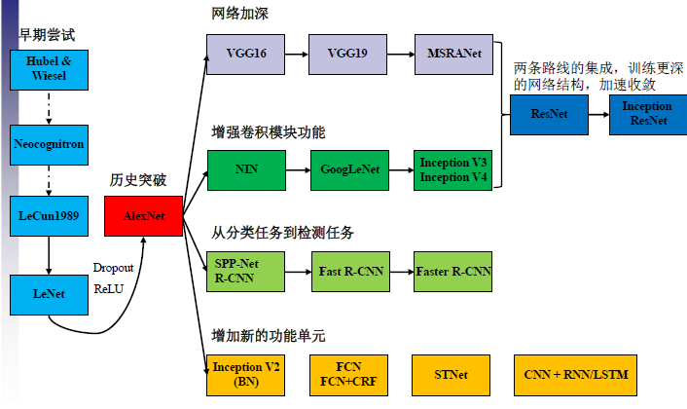
CNN结构发展

Slide 5
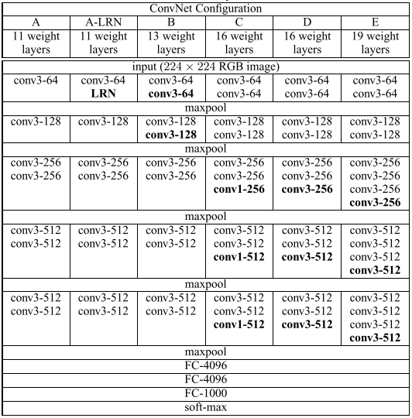
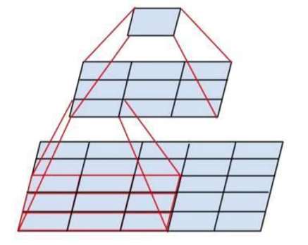
VGGNet
VGG模块
VGGNet

Slide 6
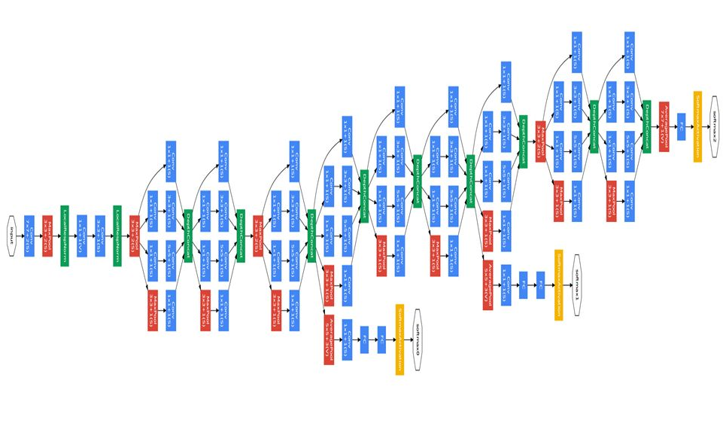
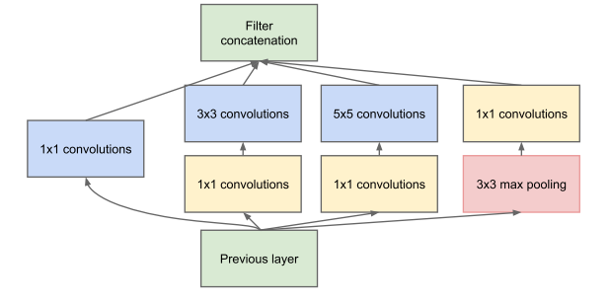
GoogLeNet
Inception模块
GoogLeNet

Slide 7
ResNet的发展
2

Slide 8
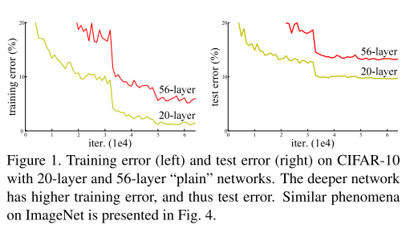
problem
Driven by the significance of depth, a question arises: Is learning better networks as easy as stacking more layers?
degradation problem
When deeper networks are able to start converging, a degradation problem has been exposed: with the network depth increasing, accuracy gets saturated (which might be unsurprising) and then degrades rapidly.

Slide 9
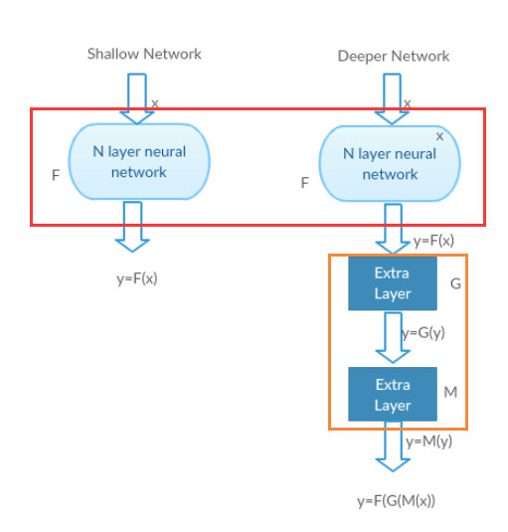
验证degradation产生原因

Slide 10
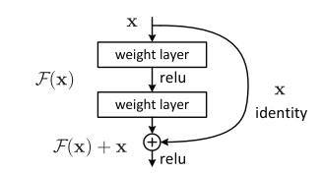
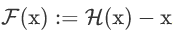
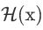
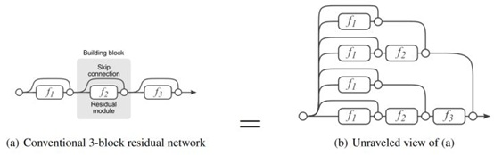
ResNet模块
为什么要学习恒等映射？
多角度理解残差结构：
1.残差角度
2.记忆角度
3.回传角度
4.集成角度
ResNet模块
ResNet集成学习

Slide 11
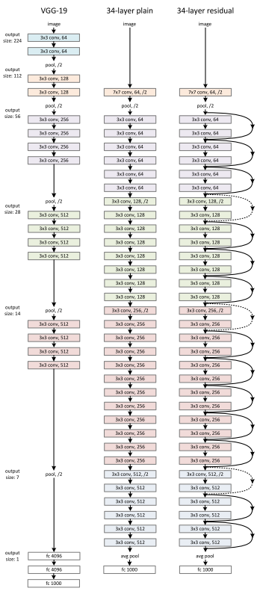
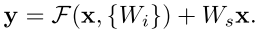
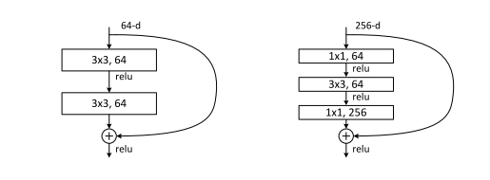
ResNet模块改进
实线：
虚线：
网络结构对比
原始模块和改进模块对比

Slide 12
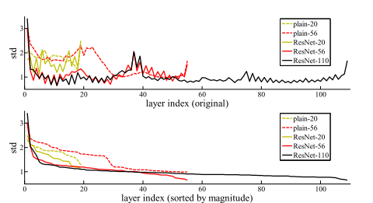
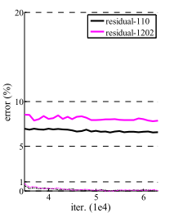
ResNet实验和后续
Standard deviations
ResNet-1202 degradation

Slide 13
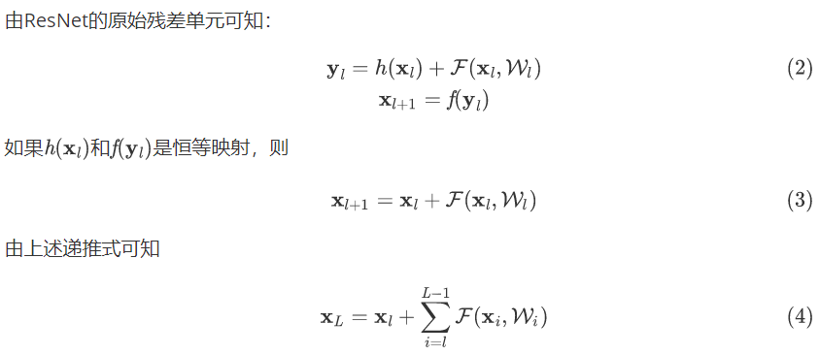
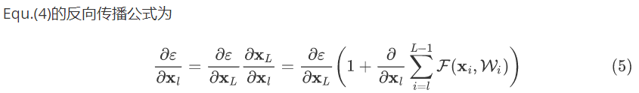
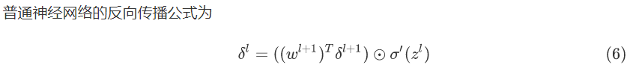
ResNetV2
ResNet公式推导

Slide 14
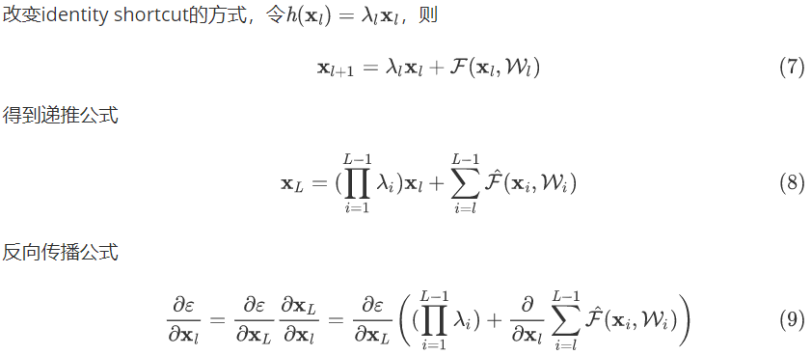
On the Importance of Identity Skip Connections

Slide 15
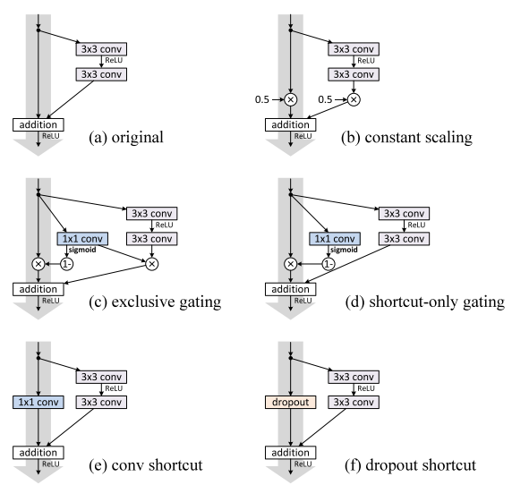
Experiments on Skip Connections
The gating and 1x1 convolutional shortcouts introduce more parameters
Various types of shortcut connections

Slide 16
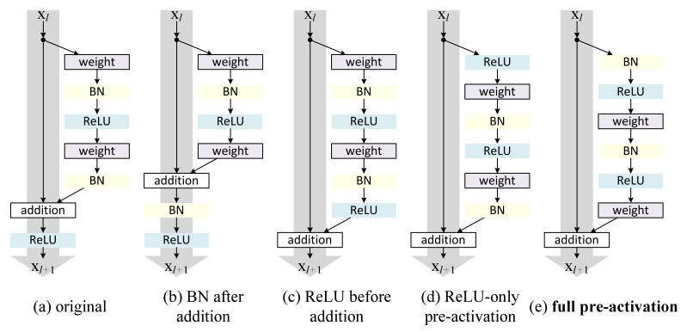
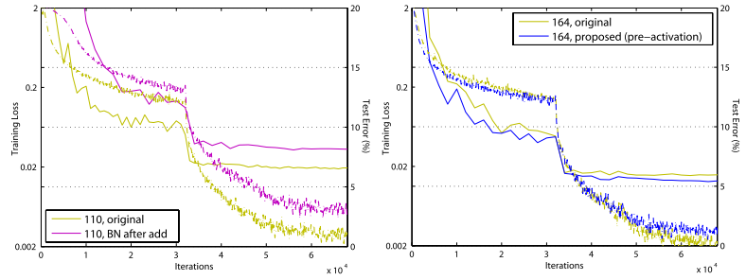
On the Usage of Activation Functions
Various usages of activation
Training curves on CIFAR-10
3个层次的改变
1.BN after addition or ReLU before addition
2. Post-activation or Pre-activation
3.ReLU conjunction with BN or ReLU not conjunction with BN

Slide 17
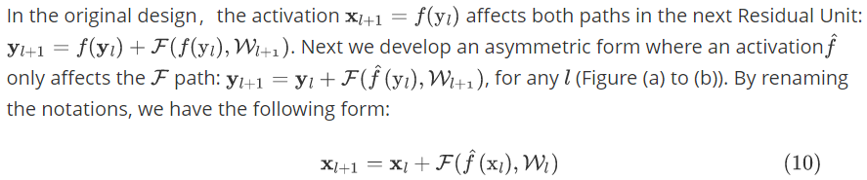
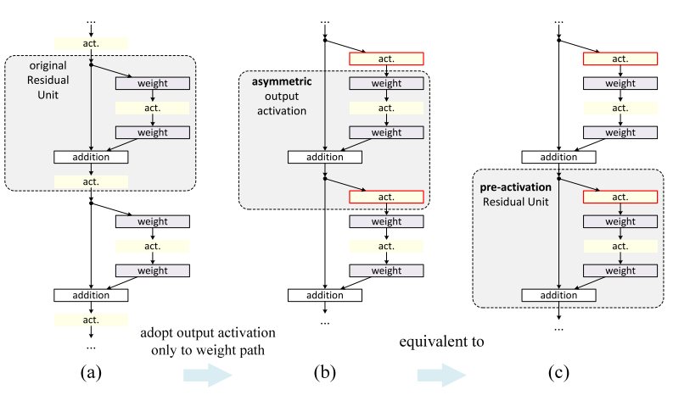
Post-activation or Pre-activation?
上一页：
(a)->(d)
(b)->(e)

Slide 18
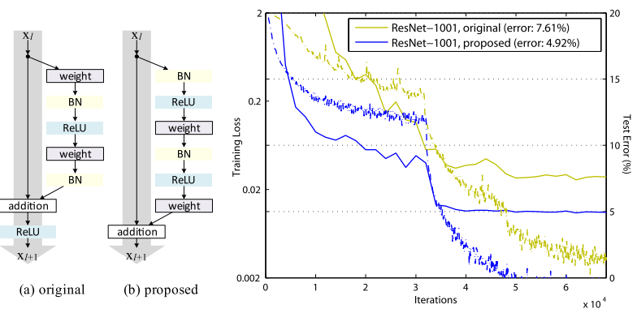
Full pre-activation 分析
为什么当ResNet层数比较少时，ReLU的影响非常小？

Slide 19
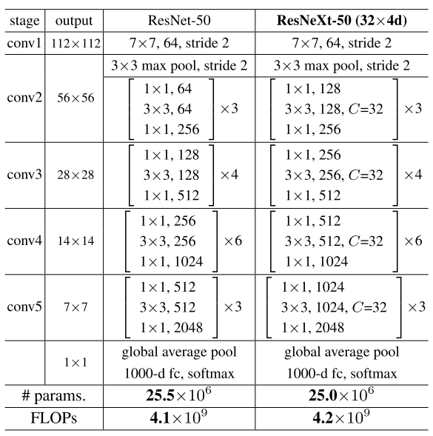
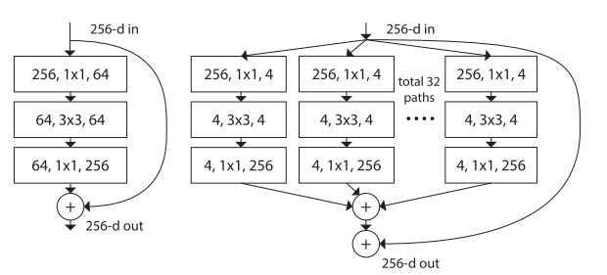
ResNeXt
思想：split-transform-merge strategy

Slide 20
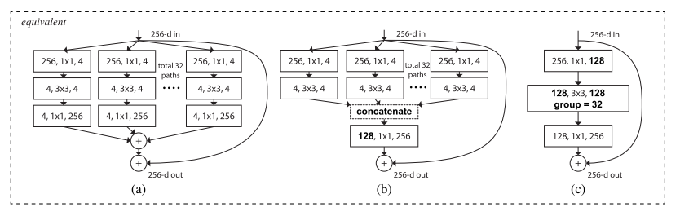
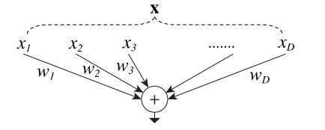
从Simple Neurons到ResNeXt

Slide 21
SENet网络
3

Slide 22
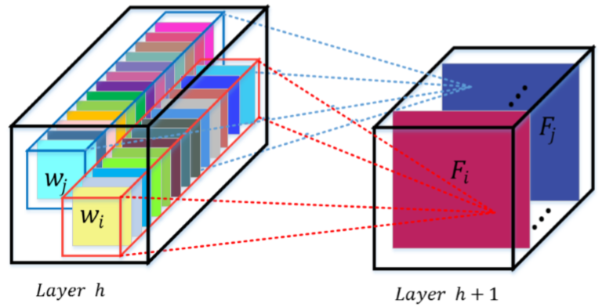
Convolution
A convolutional filter is expected to be an informative combination
Fusing channel-wise and spatial information
Within local receptive fields

Slide 23
Motivation
If a network can be enhanced from the aspect of channel relationship?
Motivation:
Explicitly model channel-interdependencies within modules
Feature recalibration
Selectively enhance useful features and suppress less useful ones

Slide 24
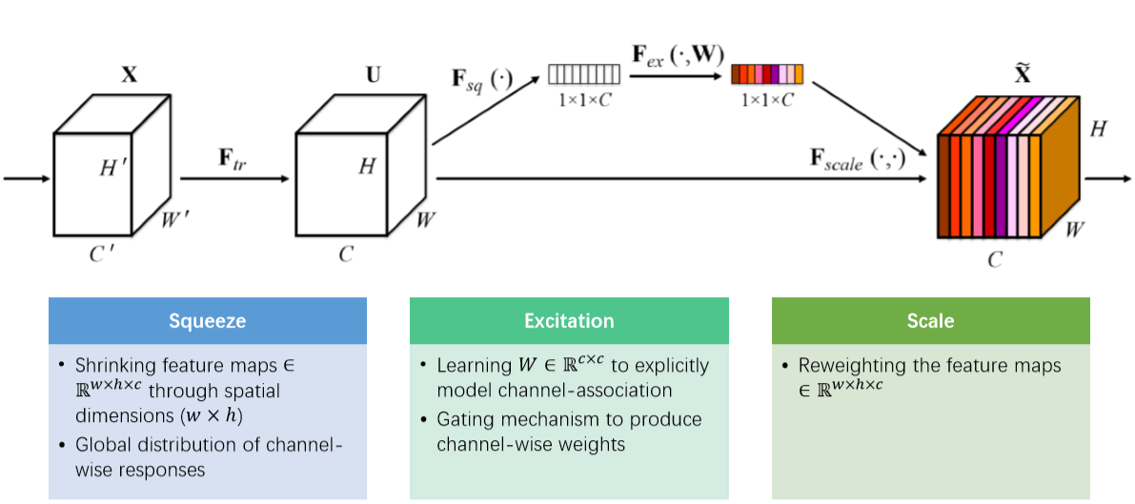
Squeeze-and-Exicitation模块

Slide 25
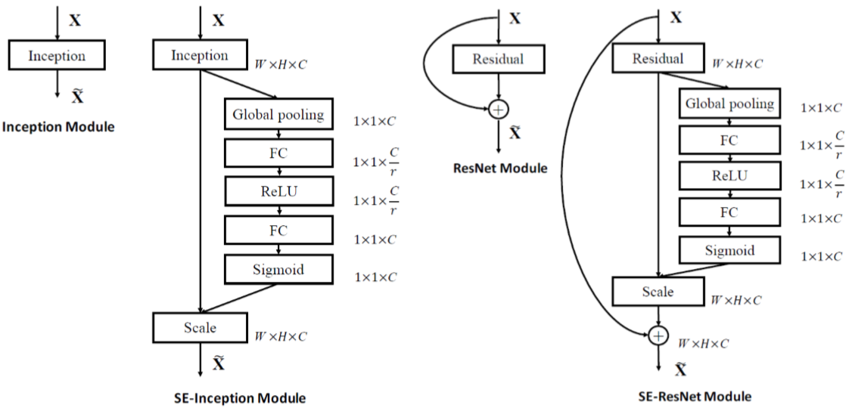
为什么使用global average pooling?
为什么引入reduction ratio r?

Slide 26
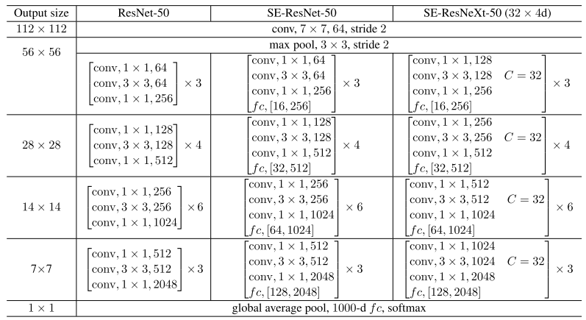
Architectures

Slide 27
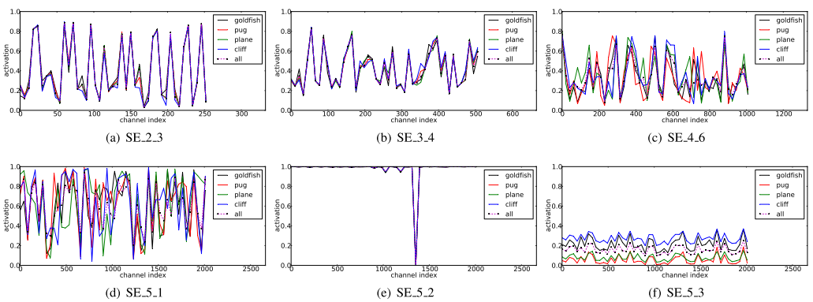
The role of Excitation

Slide 28
探讨
4

Slide 29
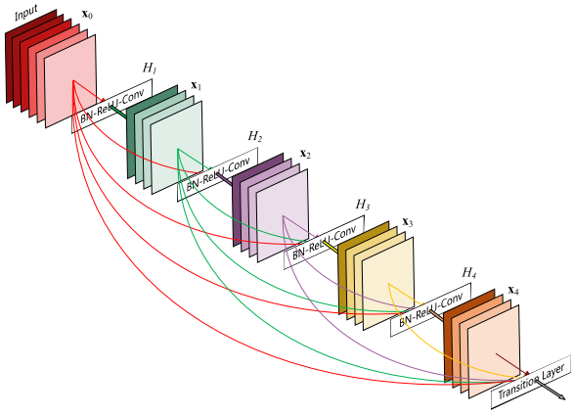
显示建模的探讨
卷积本来就是要学习一个通道之间的不同组合，为什么还要多此一举构造通道间相互依赖的SE模块呢？

Slide 30
THANKS

